Slide 1
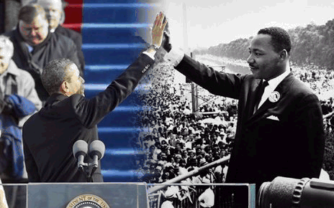
Chris Skerrit Dr. Sharon Honore Communications 120 July 18th, 2020
Mkl -

Slide 2
